Slide 1

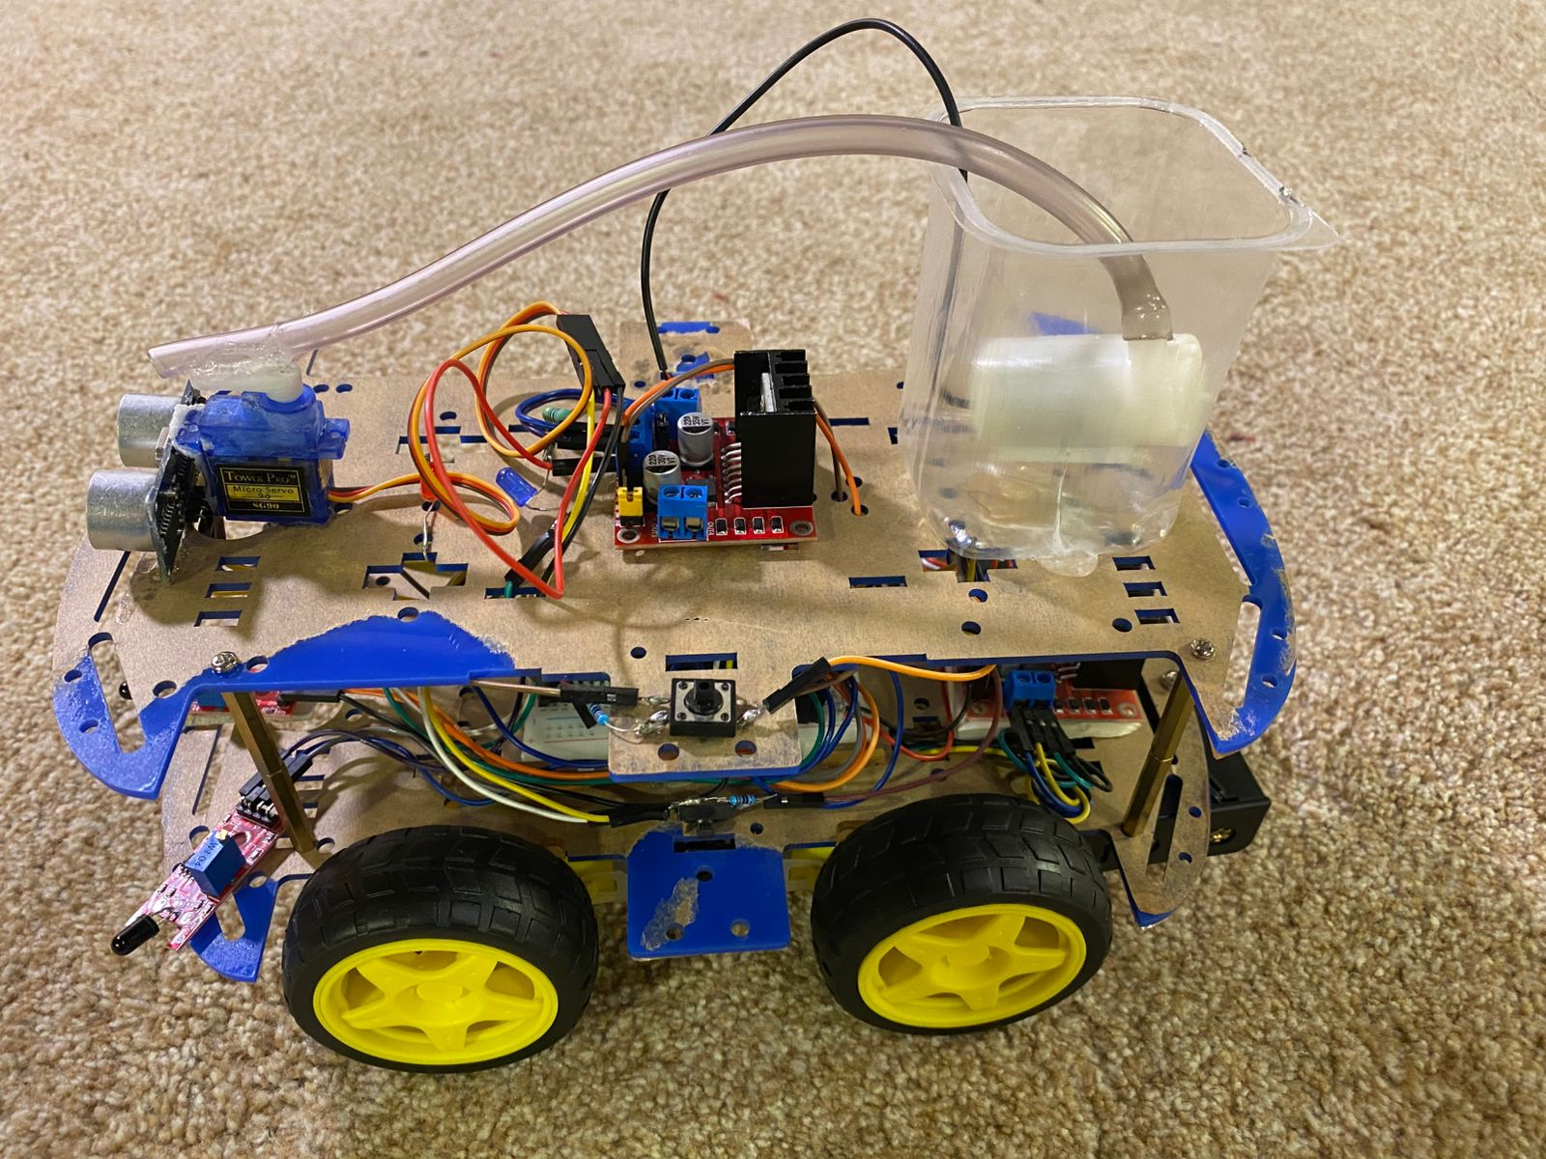
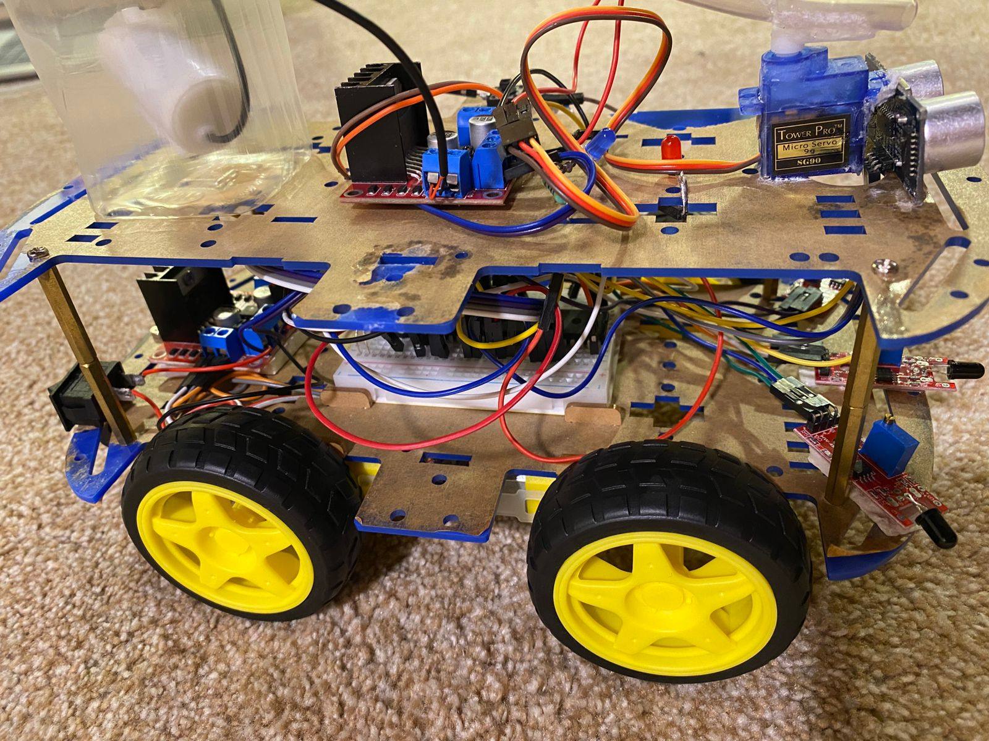
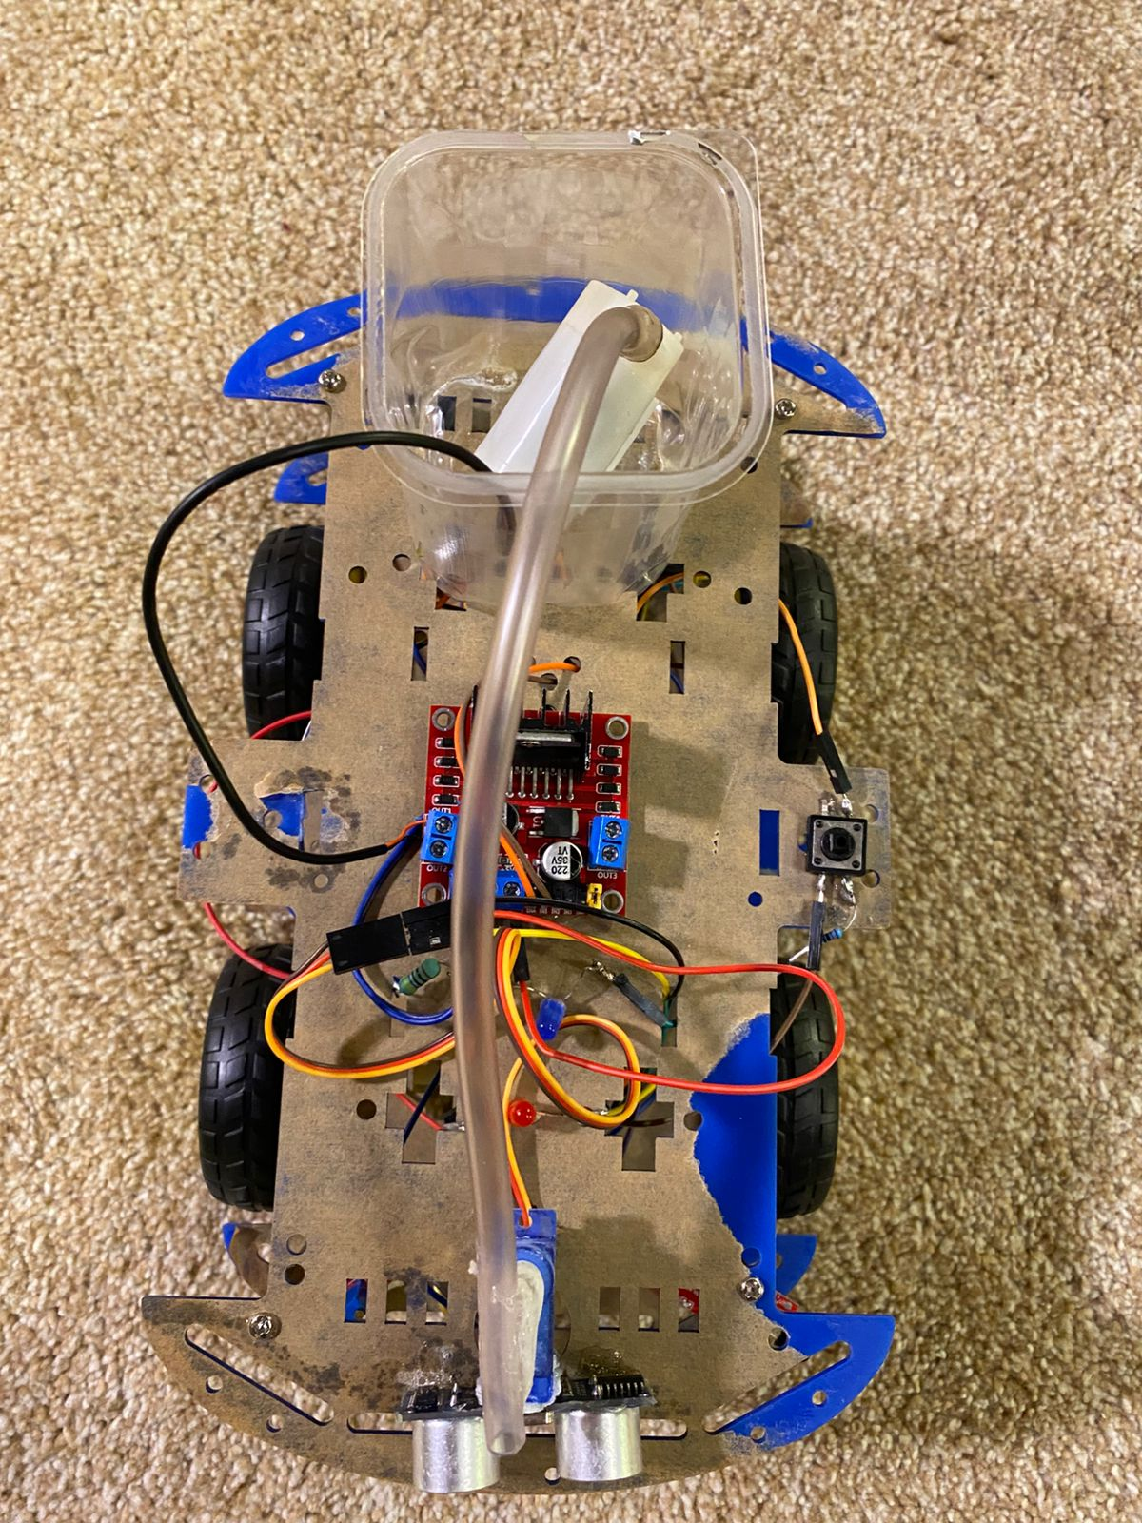
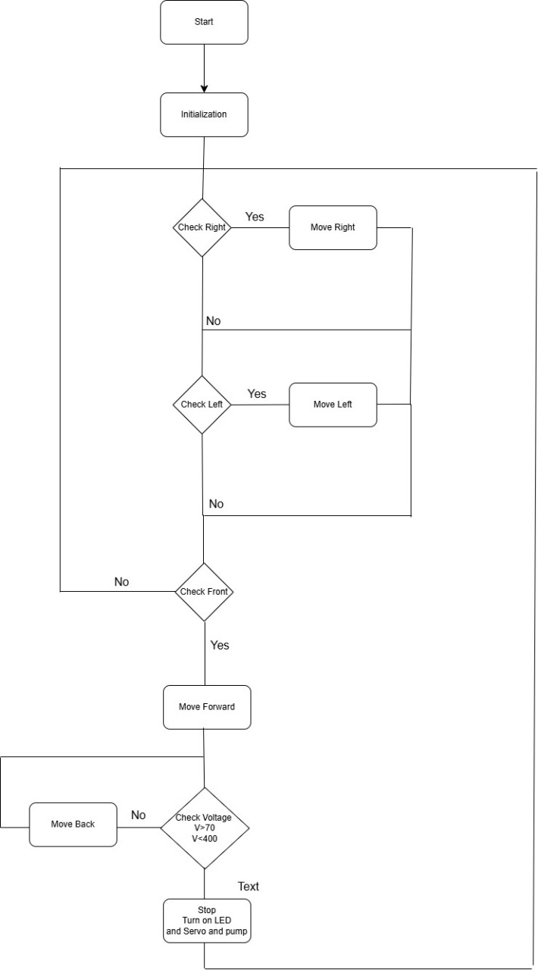
Firefighter Robot Car
A.Hiary, M.Rowad, H.Melhem,
Supervisor: Dr. Esam Qaralleh
Embedded Systems Final Design Project, Spring 2025
King Abdullah II School of Engineering
Princess Sumaya University for Technology
Introduction
This project introduces a Firefighter Robot Car built to detect and put out small fires in dangerous areas. It uses flame sensors to spot fires, a water spray system to extinguish them, and obstacle detection to move safely through its surroundings. Powered by an embedded microcontroller, the robot responds to sensor input and navigates its environment with minimal human involvement. The goal is to improve safety and provide quick response in situations where it might be too risky for people to intervene.
Results
Figure 2: (a),(b), and (c) for Mechanical design.
The mechanical design includes a four-wheel chassis for stable movement, a front-mounted water spray system for fire suppression, and carefully positioned sensors to detect flames and avoid obstacles. The layout ensures the robot can move smoothly and respond effectively in its environment.(Figure2).
Figure 3: Electrical design
The electrical design connects all the core components of the robot, including flame sensors, IR sensors, motors, and a water pump. An embedded microcontroller acts as the brain, receiving signals from the sensors and controlling the robot’s movement and fire response actions.(Figure 3).
(a)
(b)
(c)
Design
Figure 1: Software Design
The software controls how the robot thinks and reacts. It reads data from the sensors, makes decisions about where to move, and when to spray water. It also controls the motors and ensures the robot avoids obstacles while heading toward the fire.(Figure 1).
Conclusion
This project shows how an embedded system can play a valuable role in improving early fire response in hazardous situations. The robot helps support traditional firefighting efforts by handling small fires in areas that might be unsafe for people. With further development, this idea could be applied in real-world settings like warehouses, labs, and industrial facilities to boost safety and response time.

